Slide 1
Electricity Awareness Game
Submitted By
Nithin Prasanna Kumar
Binby Babu
Proposed by
Fadi Fayez

Slide 2
AIM
To create a game for kids between the age of 4 years and 6 years, to create awareness about misuse of electricity.
SCOPE
2D Game
Kids educational game.

Slide 3
Measurable Organizational Value (MOV)
Improve the knowledge of kids, on how to be cautious.
Damage caused to electrical components shall be reduced.
Children will learn how to use various electrical components.

Slide 4
EXISTING APPS
Toddler & Baby Games
MaB Goodnight
Baby Puzzles
Kids Road Safety Guide: Street walking training
Safety for Kid

Slide 5
METHODOLOGY
Spiral Technology is used, similar to most gaming apps.
Create a prototype
Rating the initial prototype on the basis of its strengths, weakness and the risks.
Explaining the necessities of the prototype followed by the initial prototype i.e. second prototype
Designing the second prototype with a suitable plan.
Building the second prototype.
Testing this prototype.

Slide 6
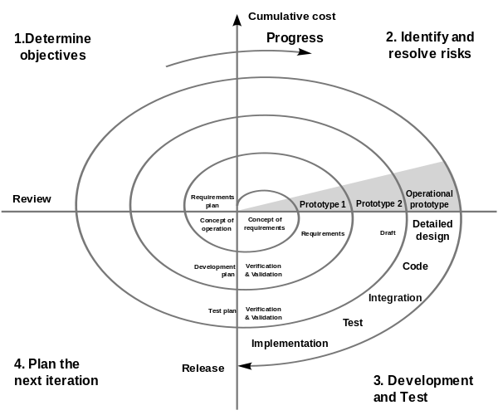

Slide 7
GAME IDEA
This game idea is inspired from various games, but most of the game is inspired from a cartoon show ‘Dora-The Explorer’.
5 different environment with 3 sub groups:
Home-Bedroom-Bathroom-Living Room
Play ground
Streets
School
Shops

Slide 8
GAME IDEA
Puzzles
Colorful Background
Attractive characters
Interactive Sections:
Joining the dots
Finding solutions to problems.

Slide 9
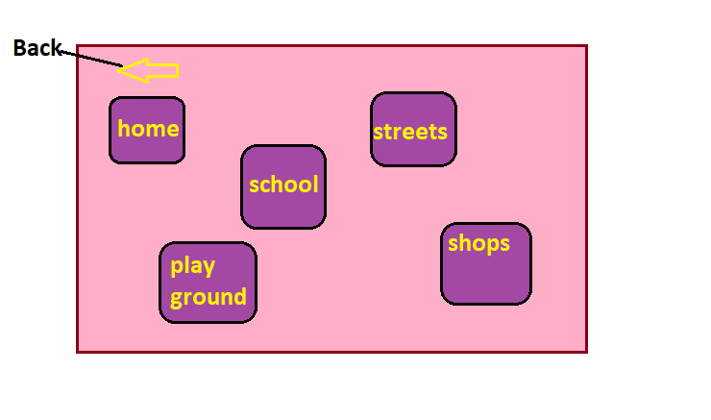

Slide 10
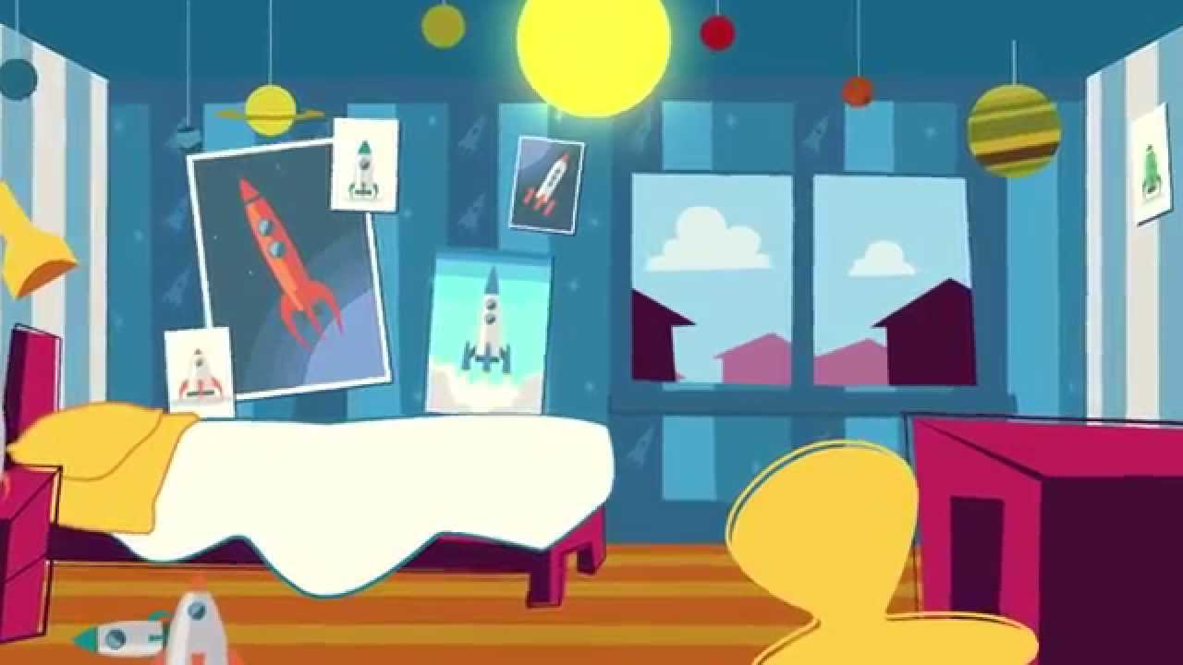

Slide 11


Slide 12
TOOLS TO BUILD
Android Studio
Eclipse
Unity 3D

Slide 13
PROJECT RISK
Time Management
Performance Risk
Lack of knowledge in game development.
Hardware and Software Failure.

Slide 14
CONCLUSION
Simple and Interactive game in a short period of time
Output should be good enough to enlighten kids about the misuse of electricity.

Slide 15
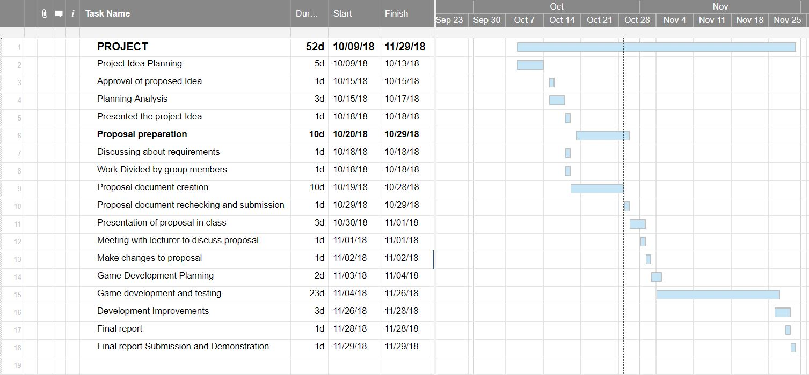
Gantt chart

Slide 16
THANK YOU!

